Slide 1
Introduction to the Fast Field Program (FFP)
Sean M. Reilly
Ocean Engineering Department
University of Rhode Island
Based on: F. R. DiNapoli and R. L. Deavenport, Theoretical and numerical Green's function field solution in a plane multilayered medium, J. Acous. Soc. Am. 67 (1), Jan. 1980

Slide 2
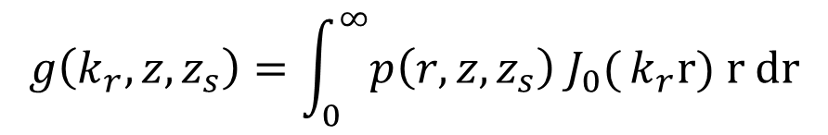
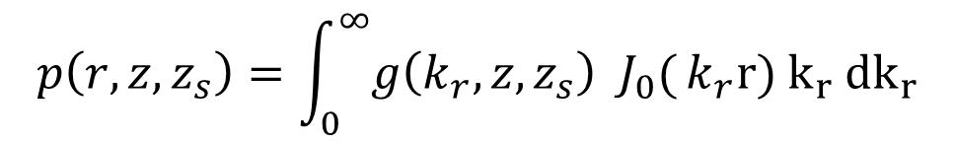
Wavenumber Integration
If we use 3-D cylindrical coordinates (r,φ,z)
And the world is symmetric in φ
Then 2-D complex pressure and its wavenumber spectrum are related by Hankel transform pair.
$$p\left(r,z,z_{s}\right)=\int_{0}^{∞}{g\left(k_{r},z,z_{s}\right) J_{0}(}k_{r}r) k_{r}{ dk}_{r}$$
2-D
Slice
$$g\left(k_{r},z,z_{s}\right)=\int_{0}^{∞}{p\left(r,z,z_{s}\right) J_{0}(}k_{r}r) r dr$$
see section 2.4.1.2

Slide 3
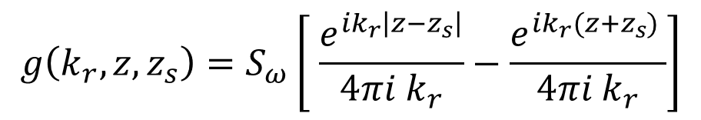

Spectrum for Lloyd’s Mirror
air
water
r
z_{s}
$$\frac{4π}{S_{ω}}g\left(k_{r},z,z_{s}\right)$$
source
z
propagating
evanescent
receivers vs. range
see section 2.4.2
$$g\left(k_{r},z,z_{s}\right)=S_{ω}\left[ \frac{e^{ik_{r}\left|z−z_{s}\right|}}{4πi k_{r}}−\frac{e^{ik_{r}(z+z_{s}) }}{4πi k_{r}}\right]$$
analytic solution

Slide 4
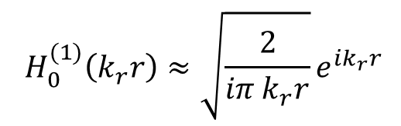
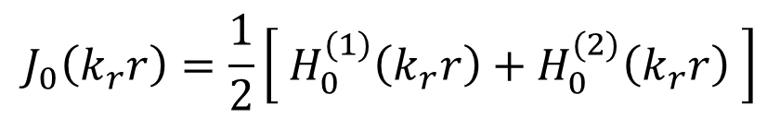
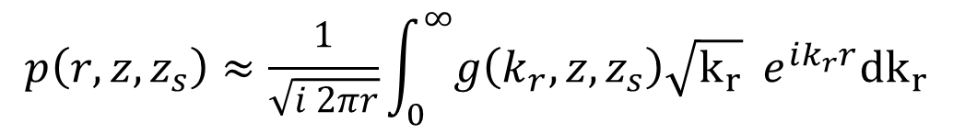
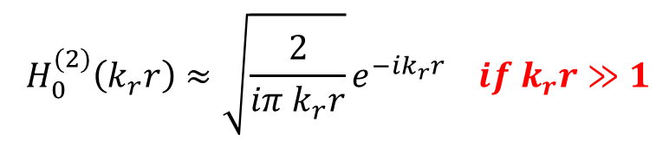
Hankel Version of Transform
Other linear combinations of 0th order Bessel functions can be used in place of J₀(k_{r} r).
$$J_{0}\left(k_{r}r\right)=\frac{1}{2}\left[{ H}_{0}^{(1)}\left(k_{r}r\right)+H_{0}^{(2)}\left(k_{r}r\right) \right]$$
$${ H}_{0}^{(1)}\left(k_{r}r\right)≈\sqrt{\frac{2}{iπ{ k}_{r}r}}e^{ik_{r}r}$$
$${ H}_{0}^{(2)}\left(k_{r}r\right)≈\sqrt{\frac{2}{iπ{ k}_{r}r}}e^{−ik_{r}r} if k_{r}r≫1$$
(outgoing wave)
(incoming wave)
$$p\left(r,z,z_{s}\right)≈\frac{1}{\sqrt{i 2πr}}\int_{0}^{∞}{g\left(k_{r},z,z_{s}\right)\sqrt{k_{r}}{ e^{ik_{r}r}dk}_{r}}$$

Slide 5

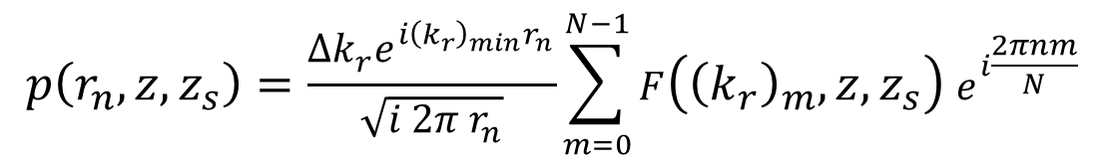


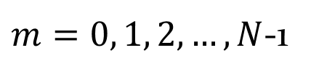
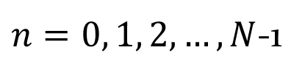
Fast Field Program (FFP)
If we limit ourselves to discreet values such that:
$$r_{n}=r_{min}+n Δr$$
$n=0, 1, 2,…, N$-1
$${(k_{r})}_{m}={(k_{r})}_{min}+ m Δk_{r}$$
$m=0, 1, 2,…, N$-1
$$Δr Δk_{r}=2π/N$$
then the result takes the form of an IFFT:
$$p\left(r_{n},z,z_{s}\right)=\frac{Δk_{r}e^{i{\left(k_{r}\right)}_{min}r_{n}}}{\sqrt{i 2π r_{n}}}\sum_{m=0}^{N−1}{F\left({\left(k_{r}\right)}_{m}, z, z_{s}\right) e^{i\frac{2πnm}{N}}}$$
$$F\left({\left(k_{r}\right)}_{m}, z, z_{s}\right)=g\left({\left(k_{r}\right)}_{m}, z, z_{s}\right) \sqrt{{\left(k_{r}\right)}_{m}}{ e}^{i m{ r}_{min}Δk_{r}}$$
see section 4.5.4
Fourier Transform is Fast if N is power of 2!

Slide 6

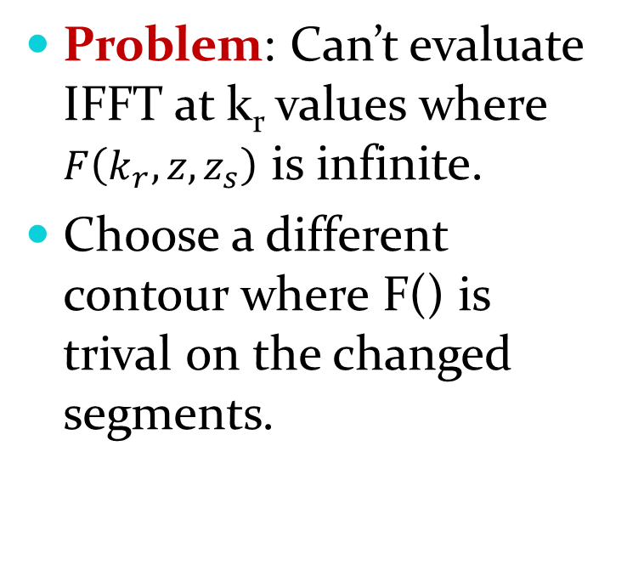

Complex Contour Integration
Im(k_{r})
contour at ∞
Problem: Can’t evaluate IFFT at k_{r} values where $F\left(k_{r}, z, z_{s}\right)$ is infinite.
Choose a different contour where F() is trival on the changed segments.
lossy
poles
Re(k_{r})
ε offset
only sig contrib
at long range
$$ε ≈\frac{3}{N Δr log(e)}$$
$${(k_{r})′}_{m}={(k_{r})}_{m}− iε$$
see section 4.5.5
recommended by book

Slide 7
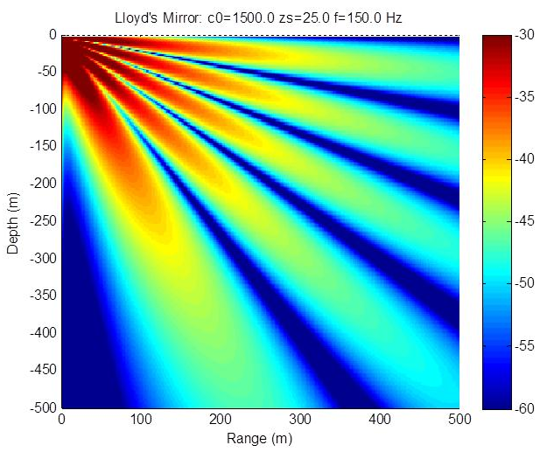
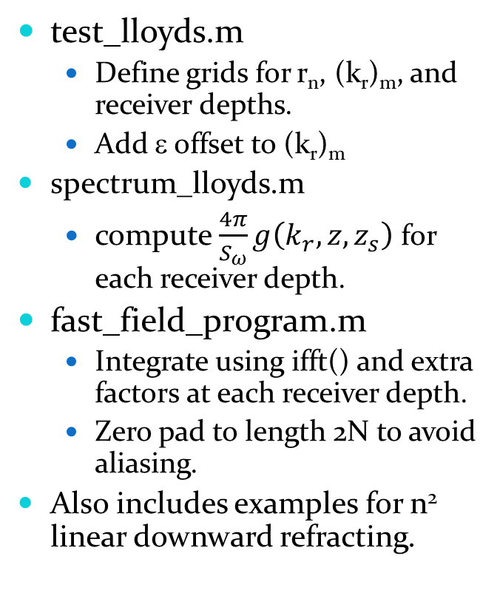

Matlab Demo: wavenum
test_lloyds.m
Define grids for r_{n}, (k_{r})_{m}, and receiver depths.
Add ε offset to (k_{r})_{m}
spectrum_lloyds.m
compute $\frac{4π}{S_{ω}}g\left(k_{r},z,z_{s}\right)$ for each receiver depth.
fast_field_program.m
Integrate using ifft() and extra factors at each receiver depth.
Zero pad to length 2N to avoid aliasing.
Also includes examples for n² linear downward refracting.
$$TL=10 log_{10}{\left|p\left(r,z,z_{s}\right)\right|}^{2}$$

Slide 8
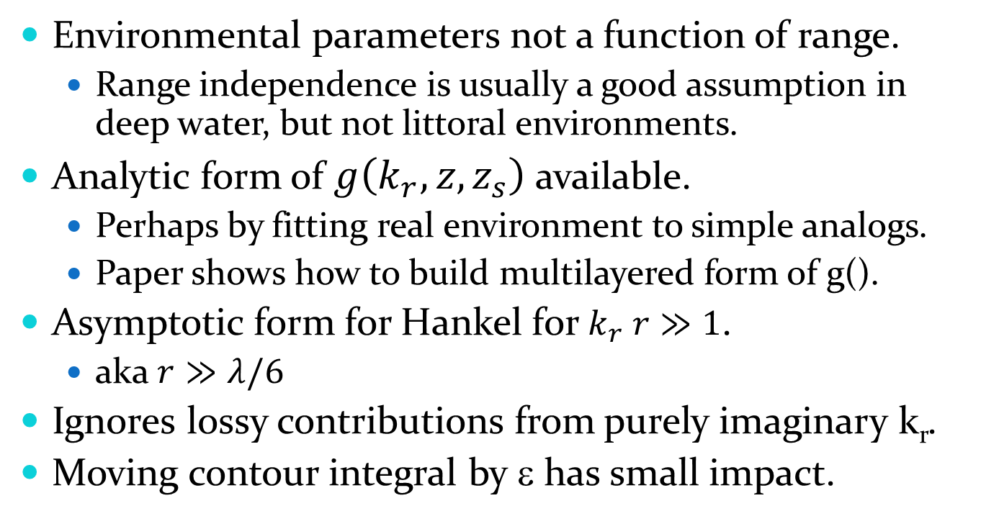
FFP Accuracy Assumptions
Environmental parameters not a function of range.
Range independence is usually a good assumption in deep water, but not littoral environments.
Analytic form of $g\left(k_{r},z,z_{s}\right)$ available.
Perhaps by fitting real environment to simple analogs.
Paper shows how to build multilayered form of g().
Asymptotic form for Hankel for $k_{r} r≫1$.
aka $r≫λ/6$
Ignores lossy contributions from purely imaginary k_{r}.
Moving contour integral by ε has small impact.

